Slide 1
The Bates Curriculum, Registration, Records, and FERPA
A Resource on Academic Policy and Academic Advising Resources
Steve Engel, Professor of Politics and Associate Dean of the Faculty

Slide 2
What is covered in this video?
Bates Curriculum and General Education Requirements
Important Dates for Fall 2024
Academic Policy Information (all of this is at the Academic Advising Portal)
A Student’s Advising Network
Bates Reach “How To” Resources
FERPA and Student Records
Degree Audit
Advisee Records on Garnet Gateway
FERPA

Slide 3
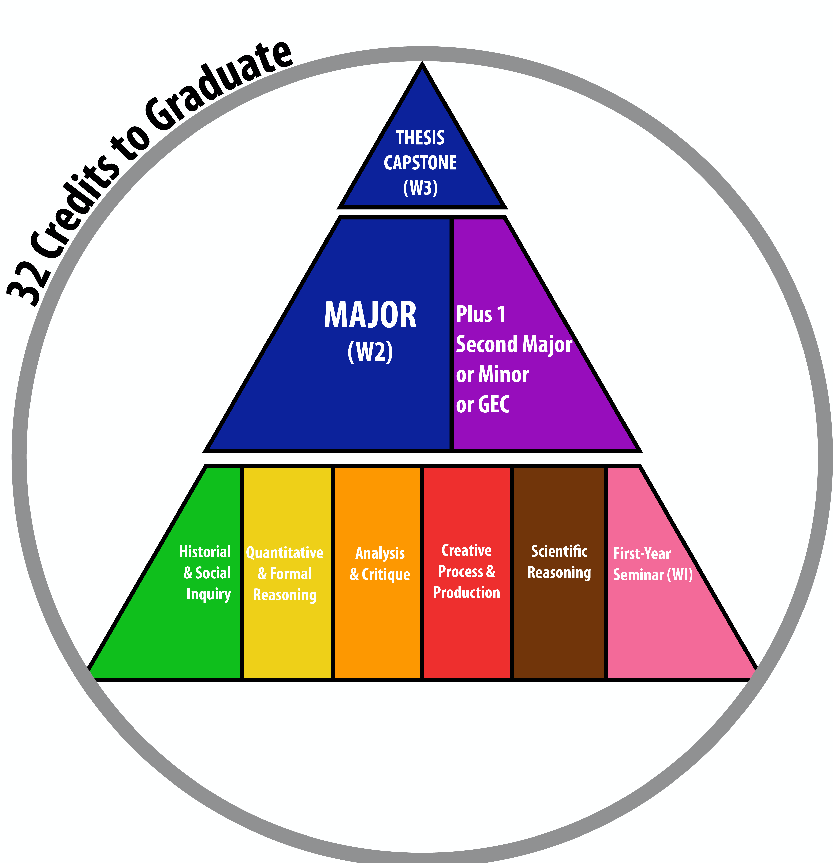
Bates General Education Requirements
General Education Requirements (all explained in more detail here)
5 Mode of Inquiry (MOI) Courses (each satisfied by at least a .5 credit course—per May 2024 legislation)
3 W courses (W1 (which is the FYS), W2 (often a course within the major), and W3 (thesis or capstone)
Major + 1 (2nd Major or Minor or GEC) (Bates Catalog)
2 short-term courses (students can take up to 3 short-term courses; they cannot take 4)
No fewer than 32 credits (4 of which can come from outside of Bates, e.g., AP, IB, or A-Level or summer study [not including study abroad/away via Global Education])
Standard academic progress yields 33 credits, which is intentional, and permits students 1 semester where they can take a “lighter course load”
Bates Catalog

Slide 4
Important Dates (Fall 2024)
All students are registered for Fall Courses
Sophomores, Juniors, and Seniors registered in March 2024; First-years registered in July 2024
Tuesday, September 3, 2024 – Add/Drop Period to adjust course schedule opens at 7 AM EDT (if a course has open seats, students can add without instructor permission through September 9)
Wednesday, September 4, 2024 – First Day of Classes
Tuesday, September 10, 2024 – Starting today, adding a class requires instructor permission
Tuesday, September 17, 2024 – Last Day to Add a Class. Last day to select the pass/fail grading mode.
Friday, October 25, 2024 – Last Day to Drop a Class. Last day to select A-F grading mode.
Week of October 28, 2024 – Academic Advising Period can begin for Winter 2025 course registration (Winter 2025 schedule of courses viewable to students on Garnet Gateway)
Saturday, November 2 (7 AM) – Friday, November 8 (4 PM) – Students can select courses (not first-come/first-served)
Registrar Calendar

Slide 5
Academic Policies
All Academic Policies can be reviewed at the Academic Advising Portal under “Academic Policies and Procedures” drop-down
This session will focus on:
Pass/Fail policy
Academic Integrity: Cheating, Plagiarism, and Unintentional Misuse of Sources
Course Deferral Policy
Academic Standing Committee
Academic Appeals
Exam Scheduling
Satisfactory Academic Progress and Minimum Academic Progress
College-wide Class Attendance Policy
Religious Holiday Observance
Note: all of these policies are 1) referred to in the sample syllabus template available through the Center for Inclusive Teaching and Learning, 2) on the Academic Advising Portal, and 3) on the Student Advising Portal

Slide 6
Pass/Fail Policy
Bates students are permitted to take up to 2 courses with a grading mode of pass/fail.
All Gen Ed courses (5 MOIs, 3 Ws, 2 short-terms, Major + 1) must be taken for a letter grade
GEC courses (GECs are 1 type of “+1”) must be taken for a letter grade to count toward the +1 requirement
The last day for a student to select pass/fail is the end of the Add period (this year: Tuesday, September 17, 2024)
The last day for a student to select A-F grade mode is also the last day they can drop a course without a Withdrawal entered (usually around the 7th Friday or this year: Friday, October 25, 2024)
Students may take a practitioner-taught short-term—these have a grading have Sat/Unsat—and that does not affect the 2 pass/fail limit

Slide 7
What if…..
What if a student wants to select pass/fail for a course after the deadline has passed?
Currently, the deadline to select pass/fail is the same day as the last day to add a course (with instructor permission—Sept 17, 2024). If a student misses that deadline, they can appeal to the Academic Standing Committee, but the Committee is not bound to accept the appeal.
Note: the last day to select a letter grade for a course is the same day as the last day to drop a course (Friday, October 25, 2024)
The separate deadlines are part of faculty-passed legislation, and they were supported by students when the faculty passed this legislation in 2012

Slide 8
Academic Integrity
Violations of academic integrity are among the most serious offenses that students can commit; any violation may result in consequences at both the course and institutional levels.
As contributors to an ongoing scholarly and creative conversation that depends upon acknowledgment and treatment of the inquiries, reflections, and expressions of others, each member of the Bates community is expected to use and represent the work of others fairly and honestly; to acknowledge the work of others fully and accurately through proper attribution and citation; and to produce their own work unless collaboration is allowed.
3 general categories of violation: cheating, plagiarism, and unintentional misuse of sources
All students are provided an overview of academic integrity policy and purposes in their First-Year Experience (FYE) Summer Resources
How can a faculty member submit an Academic Integrity Violation and what happens when a report of violation is submitted?
Go here

Slide 9
What if…
What if I think a student has committed an academic integrity violation but I am not sure?
Currently, if you have concerns about a violation of academic integrity you should connect Assistant Director of Residence Life and Community Standards Cole Taylor on next steps.

Slide 10
Course Deferral Policy (extensions)
Students are expected to complete all work assigned by faculty by the end of final exams.
In turn, faculty are expected to provide students with clear guidelines in their syllabi and in class discussions regarding all assignments, including test dates and paper deadlines.
The College recognizes that circumstances beyond the control of the student may occasionally necessitate the extension of a deadline for some course work beyond the end of the semester. In the interest of fairness and equity to all students, the reasons for such deferrals must be limited in scope.
How can a student obtain a deferral, what are the limitations on deferrals, and how is the faculty instructor of the course involved?
Go here
This policy is meant to ensure clear communication between and expectations for the faculty and student as well as that faculty are supported by the Dean of Faculty while ensuring fair and equitable treatment for students and faculty

Slide 11
What if…
What if a student becomes ill after the deadline for approval of a course deferral (e.g., becomes sick during final exam week and is thus unable to submit a deferral and postpone the exam)?
The student must petition the Academic Standing Committee to seek a course deferral once the deadline has passed

Slide 12
Academic Standing Committee
The Academic Standing Committee is made up of faculty and staff members from different departments.
This committee evaluates petitions for exceptions to academic standards, policies, and procedures. Additionally, the Committee reviews requests for registration adjustments that are not considered purely administrative in nature.
Students who believe their situation may warrant an exemption from a College academic policy or requirement may submit a Petition to the Committee on Academic Standing. Petitions are typically reviewed weekly when classes are in session, and they must be submitted via an electronic form at the ASC Petition form site.
For more information on the petition process and most common petitions and considerations go here (which is the ASC Petition form site)

Slide 13
Academic Appeals
Bates’ commitment to fairness and consistency supports an appeal process that affords students the opportunity to have certain significant decisions affecting their academic work and status reviewed.
If a student has reasonable grounds to believe that a faculty member has assigned a final grade or taken other academic action that significantly departs from established course-specific policies, is inconsistent with established College policies, or is grossly unfair for other reasons, the student may follow the appeal procedures described at this site to obtain equitable review of the matter. It is the student’s responsibility to make a timely, compelling case.
Questions can be directed to the Associate Dean for a given department or program. Go to www.bates.edu/dof. Click on Chairs to verify the Associate Dean for your department or program.

Slide 14
Exam Scheduling
If students are seeking information regarding whether an in-term exam or a final exam can be rescheduled, then they should review the policies stated here.
Student final exam times are set by the Registrar, and students are advised to not make travel plans that conflict with their appointed exam time
If a student has more than 2 final exams in a given day, they can have one moved and proctored by Accessible Education.
If faculty have a final exam time on their schedule, and they plan not to use it, e.g., your course may have a final paper due but no final exam, please notify the Registrar.

Slide 15
Satisfactory Academic Progress at Bates
A brief guide to GPA and Credit Thresholds as well as to guidelines in cases of academic dismissal is here.
Full information on the GPA and credit thresholds is in the discussion of “Satisfactory Academic Progress,” can be found in the Academic Policies section of the Catalog.
 | Standard Progress | Minimum Progress
Two Semesters | 8 Regular Semester Credits | 6 Regular Semester Credits (Bates courses)
Four Semesters | 16 Regular Semester Credits | 14 Regular Semester Credits
Six Semesters | 24 Regular Semester Credits Plus 1 Short Term Credit | 22 Regular Semester Credits Plus 1 Short Term Credit
Eight Semesters | 32 Regular Semester Credits Plus 2 Short Term Credits | 32 Regular Semester Credits Plus 2 Short Term Credits

Slide 16
College-Wide Attendance Policy
Each instructor shall, in writing, at the beginning of each semester or Short Term, make clear to the students in the course the expectations regarding attendance and nonattendance at classes and laboratories.
It is the responsibility of each instructor to outline their expectations regarding attendance at the start of each semester on the course syllabus so that each enrolled student can make an informed choice regarding the continued enrollment in the course.
A student’s participation in the work of a course is a precondition for receiving credit for the course. Students registering late or who miss class are expected to make up all missed assignments in a manner determined by the instructor.
For more information, go here

Slide 17
What if…
What if a student has an approved accommodation that does not align with course attendance policy?
The course attendance accommodation policy is here
Various resources on accessibility support as may be related to your course are here

Slide 18
Religious Holiday Observance
Bates recognizes the right of students to fulfill their religious obligations and practices. In recognition of Bates’ commitment to a diverse and inclusive student body and the variety of religions observed and practiced by our students, faculty are encouraged to consult the Multifaith Calendars posted online by the Office of the Multifaith Chaplain when developing course syllabi so that conflicts between in class examinations and major religious holidays may be avoided.
Given the range of faiths embraced by our students, it may not be possible to avoid all conflicts between scheduled examinations and religious holidays. Students are expected to approach the instructor within the first 3 weeks of the semester if there is a conflict between a scheduled examination, paper, or project due date and a significant religious holiday observed by the student.
The Office of Accessible Education will continue to be available to proctor makeup exams for students who miss an exam due to observance of a significant religious holiday, illness, severe medical or psychological issues, or personal emergencies.

Slide 19
A Bates Student’s Advising Network
Each Bates student has 2 advisors
Academic Advisor: Until a student declares a major (no later than March 1 of their second year), their pre-major academic advisor is most often their First-Year Seminar instructor. Once a student declares a major, a faculty member within that academic unit becomes their academic advisor. Students also receive an advisor in their minor, should they declare one. The academic advisor helps students explore the curriculum to discover their interests and to fulfill requirements.
Student Support Advisor (SSA): The Student Support Advisor supports student success by ensuring they know whom to go to when they need guidance, assistance, or just someone to talk to. Students are assigned a Student Support Advisor prior to their matriculation and remain with their advisor for the duration of their enrollment at Bates. While their pre-major academic advisor – who is their First-Year Seminar (FYS) instructor – provides the primary academic advising for students, Student Support Advisors are an additional point of contact and support for students who have concerns or questions about their academic plans.
First-Year students have 2 peer advisors in addition to the 2 professional advisors
Residential Junior Advisor (JA): At Bates, all first-year students live within First-Year Centers in the residence halls. Each FYC has an assigned junior advisor (a residential advisor often a sophomore or junior) who serves as a key peer resource to assist students in navigating opportunities at Bates. Most common questions about residence life at Bates, e.g., housing accommodation, roommate information, etc., are answered at the Office of Residence Life and Health Education website.
Writing Course-Attached Tutor (W-CAT): At Bates, all first-year students enroll in a First-Year Seminar (FYS) during their Fall semester. Each FYS includes a peer writing tutor, who is a sophomore, junior, or senior who serves as a key resource to assist students in developing their writing and communication skills within the FYS. First-year students can meet with their FYS W-CAT throughout the Fall semester to review FYS assignments with them as well as to get assistance on the First-Year Experience Workshops, which are tethered to the FYS. The W-CATs are part of the student staff at the Student Writing and Language Center, which is part of the Peer Learning Commons. The Peer Learning Commons is on the Ground Level of Ladd Library.

Slide 20
What if…
What if a student tells me they do not have an academic advisor?
The academic advisor and the student support advisor are listed in both Bates Reach and the top of a student’s Degree Audit.
If the student’s SSA is no longer at the college, the student should be in touch with Assistant Dean of Accessible Education and Student Support Jess Berry
If the student is declared in a major and their academic advisor is on research leave or no longer at the college, the student should be referred to the chair of the academic unit for support
If the student is not yet declared in a major (a first-year or a sophomore), the academic advisor is the FYS instructor. If the sophomore student says they don’t have an academic advisor, they should be in touch with Associate Dean of the Faculty and Professor of Politics Stephen Engel

Slide 21
Bates Reach
an online tool that will make it easier for students to reach out to their advisors and professors, and vice versa.
When students access Bates Reach via their Garnet Gateway, their landing page is “My Success Network”
Here students will see all the staff and faculty who they are working with during a particular semester — not just the people teaching their courses, but their advisors, department chairs, and others involved in their progress.
Students can book appointments directly through BatesReach. As their connections change from semester to semester, My Success Network is updated right along with them.
First-Year Students are prompted to explore various training materials regarding BatesReach as part of their FYE Workshops. Student-facing materials are here. A student-oriented FAQ is here
Faculty and Student Support Advisors can access training materials on BatesReach here. A Faculty and SSA-oriented FAQ is available here

Slide 22
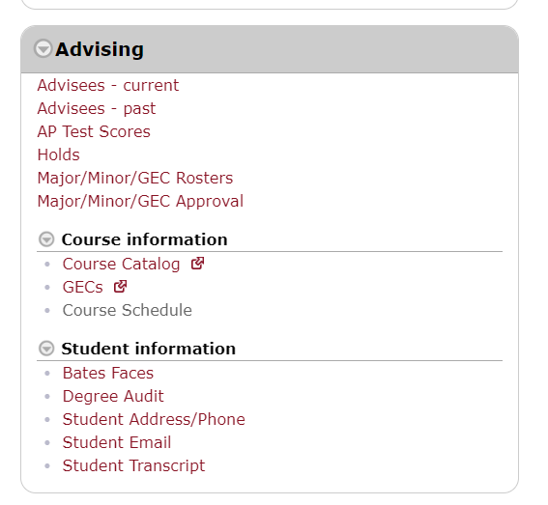
Degree Audit
This software allows you to access the record of your advisees to see the progress they’re making toward their degree requirements. It’s accessible from the Advising section of the Faculty menu in Garnet Gateway.

Slide 23
Degree Audit
This section includes important details about the student’s record.
This section gives an overview of the requirements that are being checked for the student.
The rest of the audit displays the detail of the student’s progress toward each requirement.

Slide 24
Advisee Records
You can access information about your advisees via the Advising section of the Faculty menu in Garnet Gateway. The advising roster includes students’ unofficial transcripts and other details about their record.

Slide 25
FERPA
What is FERPA?
The Family Educational Rights and Privacy Act of 1974 (FERPA) protects the privacy of student records. It establishes the student’s right to limit disclosure of their education records; to inspect and review their records; and to request corrections to their records. We notify students of their rights in the Catalog and Student Handbook.
What is an education record?
With a handful of exceptions, just about any information related to a student and maintained by Bates or a person acting for Bates is an education record and is subject to FERPA. The medium of the record doesn’t matter.
Exceptions include certain law enforcement records, employment records, medical records, post-attendance records, and sole possession records. Sole possession records are things maintained by you and not accessible to any other person, like notes you’ve made to jog your memory in an advising session.

Slide 26
FERPA
What are the rules?
With a few exceptions, a student’s education record is confidential and can’t be released without the written consent of the student.
You have a responsibility to protect education records in your possession or that you come across in the nature of performing your work, and this extends to all students, not just your advisees.
If you’re ever in doubt about whether it’s okay to release something, contact the Registrar’s Office for advice.

Slide 27
FERPA
What are some ways you might accidentally violate FERPA?
Failing to properly protect student records.
Examples of this might be throwing away protected information in a regular trash can rather than shredding it, or not locking your computer screen when leaving it unattended.
Posting protected records in a publicly accessible location for students or others to sort through.
An example of this might be leaving a box of completed exams outside your office door for students to pick up.
Using student record information for reasons beyond its intended purpose.
An example of this might be analyzing grade or other student data for personal interest or to write your own paper.

Slide 28
Thank you!!
If you have questions about course registration or records matters that you cannot answer yourself with the resources provided here or at the Academic Advising Portal: registrar@bates.edu
If you have questions about general education requirements or academic policy matters:
Dean of Faculty Office – Steve Engel (sengel@bates.edu)
Student Affairs – Erin Foster Zsiga (efoster@bates.edu)
Bates Reach –Jess Berry (jberry4@bates.edu)

