Slide 1
Course Registration for Winter 2025 Classes: Some Basics for Academic Advisors
Tuesday, October 8
Noon – Commons 226

Slide 2
What will be covered…
The timeline of the registration process
The general education requirements
Information for students by class year
Reading the course schedule on Garnet Gateway
Resources
Important Reminders

Slide 3
Timeline of the Course Registration Process
Monday, October 21, 2024 – All-student email goes out from Engel at or near 7 AM (detailing the registration process and timeline, pointing students to set up appointments with advisors, pointing students to the “how to” videos at the Student Advising Portal, and highlighting important information by class year)
Friday, October 25, 2024 – Final/Complete Winter 2025 Course Schedule visible on Garnet Gateway or or near 4 PM Eastern
Monday, October 28, 2024 – Academic Advisors can begin having advising meetings with their advisees (general recommendation: when scheduling meetings, remind students to come prepared to the meeting, e.g., they should review their Degree Audits, review the course schedule, begin to identify possible courses) – email templates are available at the Academic Advising Portal
Friday, November 1, 2024 – Students can begin to register at 9 AM Eastern for up to 4.5 Bates Credits (Round 1)

Slide 4
Timeline of the Course Registration Process
Friday, November 8, 2024 – Registration (Round 1) closes at 4 PM Eastern
Tuesday, November 12, 2024 – Round 1 results are made available to students on Garnet Gateway. If students have 4 credits and are satisfied with results they are done and no further action is necessary; they can adjust schedules once the Add/Drop period opens.
Wednesday, November 13, 2024 – Petitioning (Round 2): If a student selected a course that they did not get into at the end of Round 1, they can submit a short petition on Garnet Gateway (1 to 2 sentences) detailing their reasons for seeking admission to an open seat in the class. They can do so until 11:59 PM on Sunday, November 17, 2024
NOTE: Petitioning is legislated by the faculty; my (Steve’s) understanding is the legislation dates back to 1992.

Slide 5
Timeline of the Course Registration Process
Monday, November 18 to Sunday, November 24 – Faculty review, accept, or reject petitions on Garnet Gateway.
Monday, December 2, 2024 – Updated schedules available for students to review on Garnet Gateway
Tuesday, December 3, 2024 – Add/Drop (Round 3) opens to students. Students can adjust their schedules up to 5.5 credits by adding and/or dropping courses from their schedule. Adding will continue into the third week of the Winter semester (the latter half with permission of instructor only). Drop deadline is later—usually late February.

Slide 6
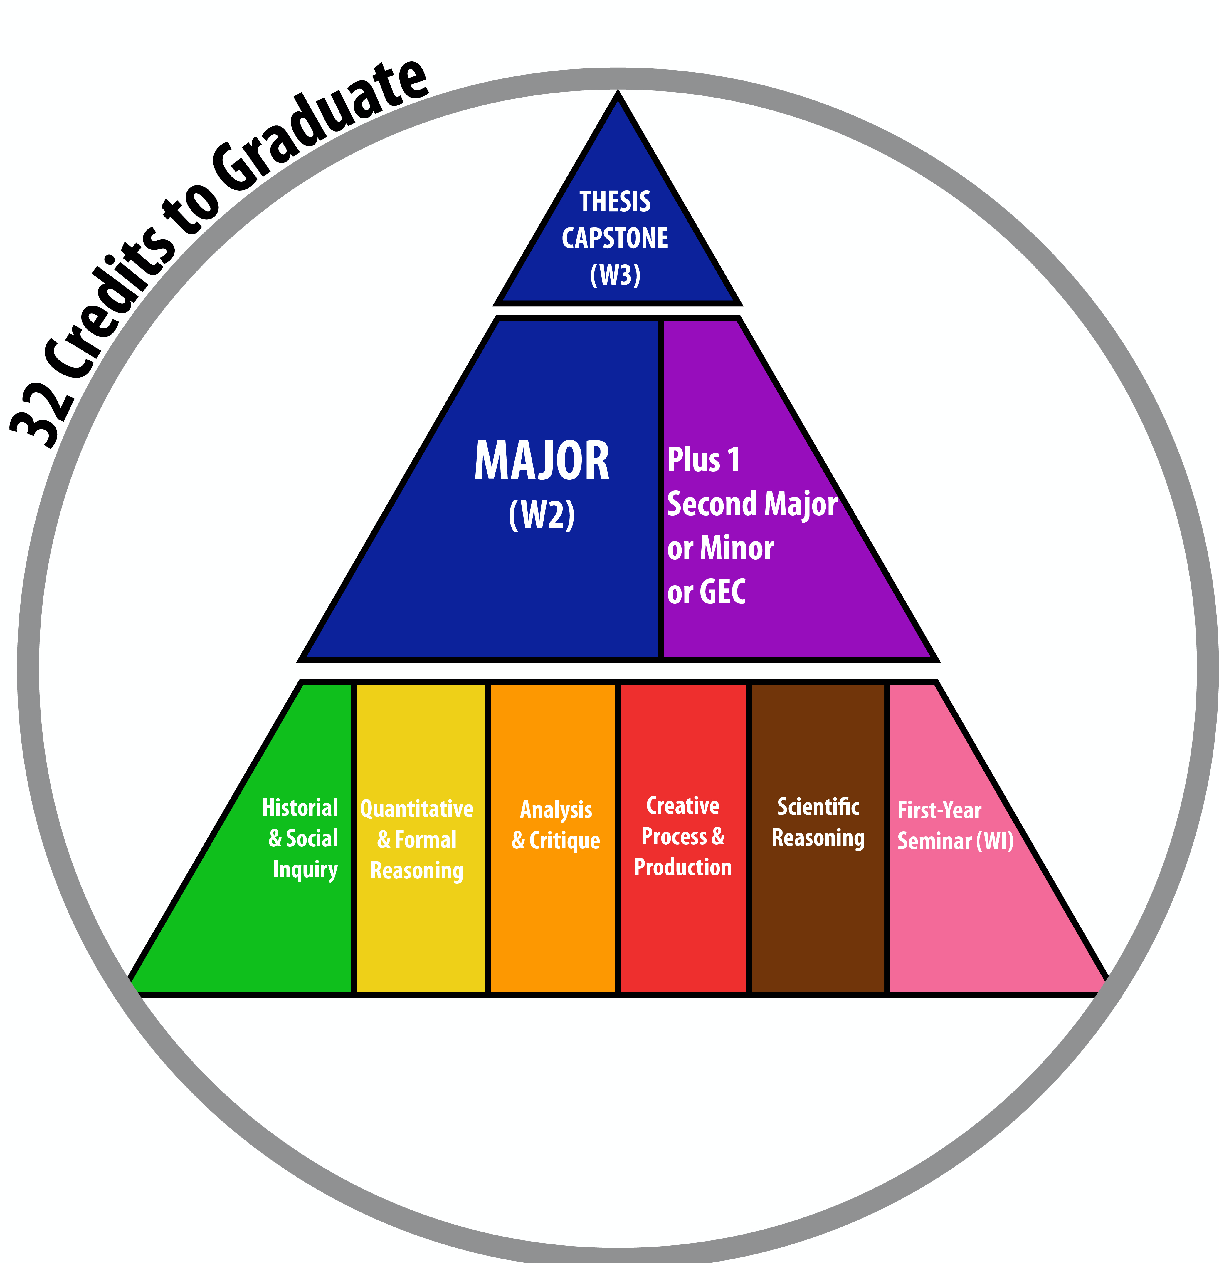
Bates Curriculum and Gen Ed
General Education Requirements (all explained in more detail here)
5 Mode of Inquiry (MOI) Courses (each satisfied by at least a .5 credit course—per May 2024 legislation)
3 W courses (W1 (which is the FYS), W2 (often a course within the major), and W3 (thesis or capstone)
Major + 1 (2nd Major or Minor or GEC)
2 short-term courses (students can take up to 3 short-term courses; they cannot take 4)
No fewer than 32 credits (4 of which can come from outside of Bates, e.g., AP, IB, or A-Level or summer study [not including study abroad/away via Global Education])
Standard academic progress yields 33 credits, which is intentional, and permits students 1 semester where they can take a “lighter course load”

Slide 7
Information by Class Year (all indicated on Student Advising Portal)
Juniors (Class of 2026)
If away, their holds are lifted, but they may want to Zoom with their academic advisors
If currently away, they will want to complete major, minor, GEC, and MOI credit transfer forms when they return
If they are planning to study abroad, discuss with them how they will complete these forms when they return in Fall 2025
First-Years (Class of 2028)
Focus on completing MOIs and exploring different subject areas
Adding any non-Bates credits to Degree Audit (AP, IB, A-Level)
Sophomores (Class of 2027)
Major + 1 Declaration
MOI Completion
Use “What If” Function on Degree Audit
Pay attention to Global Education Deadlines (Major Declaration by February 1)
Seniors (Class of 2025)
If they have not completed their MOIs, they must do so (do not rely on Short Term)
They should have completed all Major+1, MOI, and W requirements by the end of Winter 2025 (a short term may be feasible in some majors)
They should be at 31.5 or 32 credits by the end of Winter 2025 (If 31.5, ensure they are eligible for short term 2025 (students can only take 3 short terms)

Slide 8
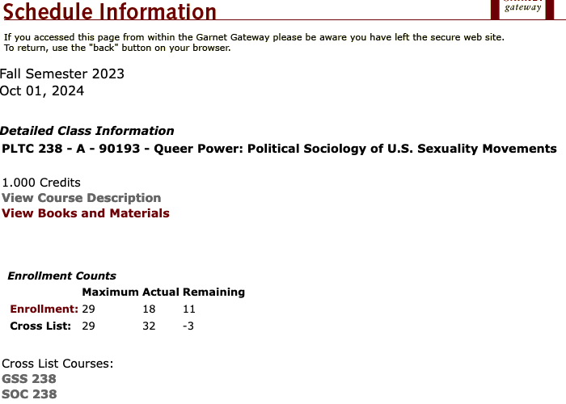
Reading the Course Schedule on Garnet Gateway
If you click on the 5-digit code (CRN) you can see that the course is crosslisted
If a course is cross-listed seat availability will be listed in the 2nd set of 3 numbers (XL Cap, XL Act, and XL Rem)
Cap is the course cap, e.g 29
Act is the Actual Number of Students Enrolled (during round 1 this will indicate the number of students who have selected the course)
Rem is the Remaining Number of seats that are open (a negative number means the faculty member has decided to “bust through” the cap via permission of instructor)

Slide 9
Resources
How to Register Video (on or near October 15)
Available at www.bates.edu/registrar
Posted to the “How to Register” section of the Student Advising Portal and the Academic Advising Portal (for Faculty)
For First-Years it will be at the FYE Workshops Lyceum Page
All Student Email
An email detailing the process of registration, recommending that students contact their advisors to set up meetings to review academic plans and have their registration hold lifted, and providing information by class year will go out to all students on Monday, October 21, 2024 at 7 AM.
This email will be posted at the “Important Communications with All Students” section of the Student Advising Portal
Degree Audit
“What If” Function to test out possible Majors, Minors, and GECs
NOTE: This function will not work if the major requires a “concentration” and it is not selected
Calendars
The registration process dates and deadlines are listed at 2 calendars
Registrar calendar at www.bates.edu/registrar
Important Dates and Deadlines Calendar at the Student Advising Portal
Advisor Email Templates
Steve will work to have email templates for communication with academic advisees ready on or near October 21, 2024. They are located at the Academic Advising Portal for Faculty

Slide 10
Important Reminders
The Registrar cannot issue overrides for pre-requisites, instructor permission, capacity, class restrictions, etc. (Only the instructor can).
Academic Advisors are responsible for advising in both the major and the general education requirements. Do not refer a student to the registrar for advising in general education requirements.
Advisors need to be available to lift the hold. Only the academic advisor can lift the hold. Please make sure you lift the hold. The registrar does not lift the hold. The student support advisor does not lift the hold. Holds must be lifted or students cannot register.

Slide 11
Thank you!
If you have questions that are not answerable by the resources provided in or referenced by these slides, please reach out to either registrar@bates.edu or sengel@bates.edu.

